Slide 1
Computer Graphics: Line drawing Algorithms

Slide 2
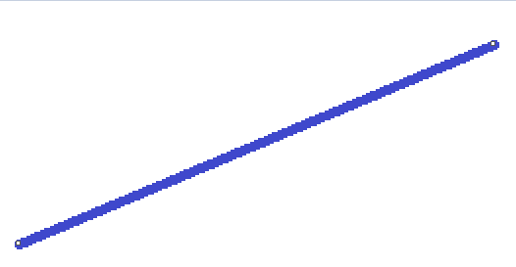
Draw a Straight Line in MS-Paint
Now increase Line Width

Slide 3
Is It a Stair-step or what!
Pixels are discrete, they belong to Computer’s Display Unit
Why did these happen?
It is not a continuous Line
Coordinates are Continuous

Slide 4
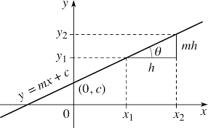
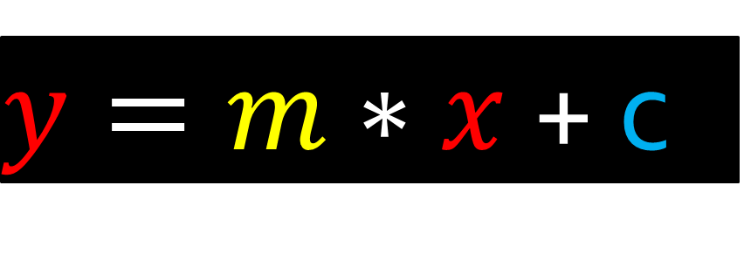
Into The Straight Line
$y=m∗x$ + c
m=$\tan{θ}$
c ➔ intercept on Y-axis

Slide 5
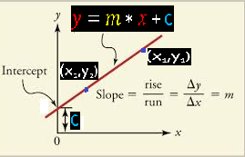
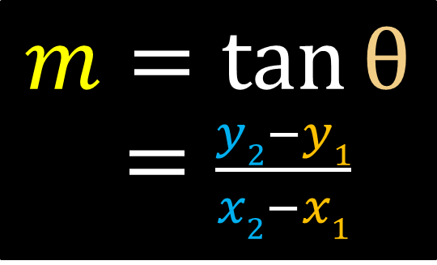
Significance of $m$
$$m=tan{θ}$$
= $\frac{y2−y1}{x2−x1}$
∴ $m$ ➔ change of value of Y per unit change of value along X axis
$m$ = $\frac{dy}{dx}$

Slide 6
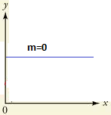
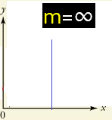
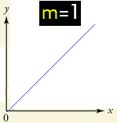
Case Studies on $m$
m=0 ➔ the Line is parallel to X-axis
m=∞ ➔ the Line is parallel to Y-axis
m=1 ➔ the line is inclined at 45 degree
Note: See-Saw Steps are less in 3 cases above

Slide 7
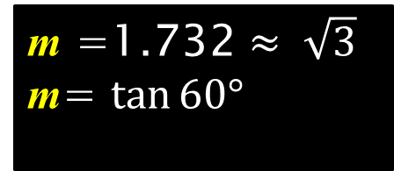
Because, Pixels are Discrete
$y=1.732∗x$ + 2
m =1.732 $≈ \sqrt{3}$
m= $\tan{60°}$
∴
Let is Plot now!
x | y | Decision?
0 | 2 | Exactly 2
1 | 3.732 | 3.8 (Impossible) or 4?
2 | 5.464 | 5 or 5.5 (Impossible)
3 | 7.196 | 7.2 (Impossible) or 7
4 | 8.928 | 9 Or 9.3 (Impossible)
Thus, plotting on Graph is not accurate For, pixels are discrete while points are not!

Slide 8
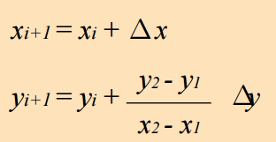
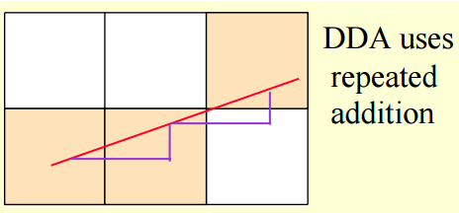
Line drawing Algorithm-1: DDA

Slide 9
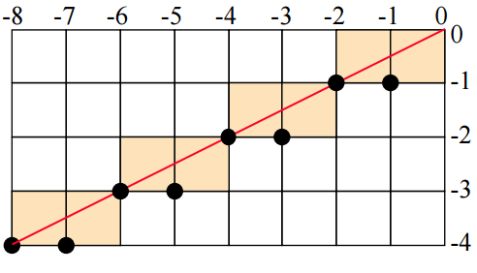
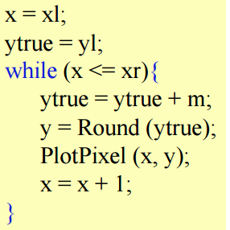
Case -1 : |m| ≤ 1
Switch roles of x and y for |m| >1

Slide 10
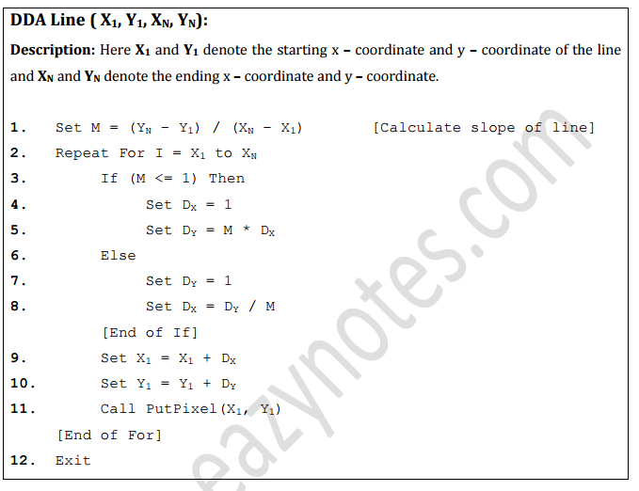
DDA: Easier and Generic Approach
Plotting a Pixel
Differs across
Programming
languages

Slide 11
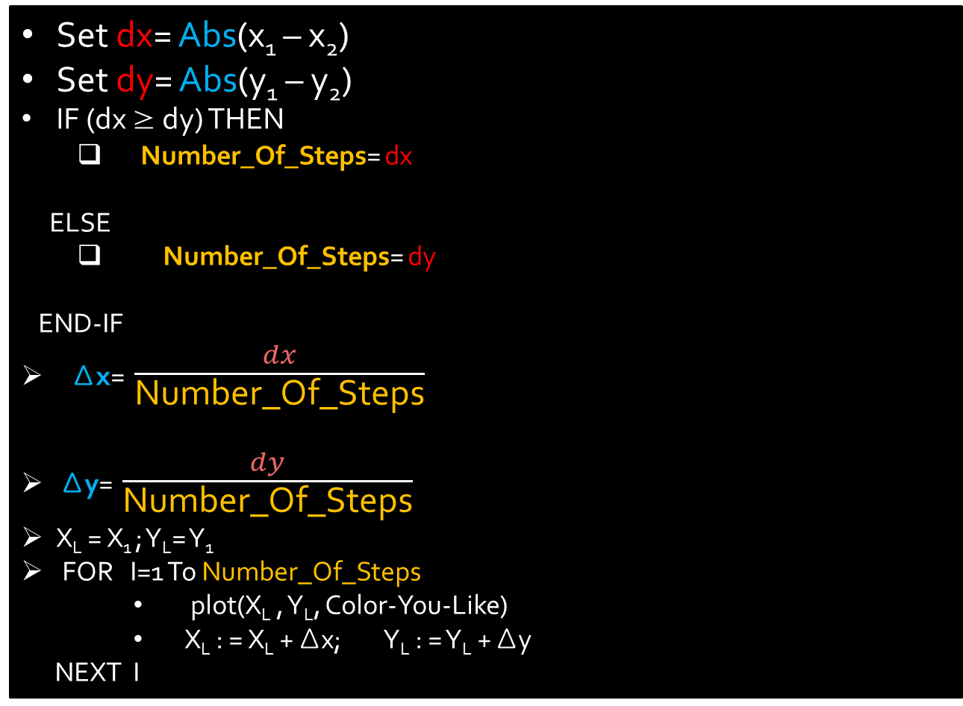
Do Yourself: Deduction from DDA Algorithm
Set dx= Abs(x₁ – x₂)
Set dy= Abs(y₁ – y₂)
IF (dx ≥ dy) THEN
Number_Of_Steps= dx
ELSE
Number_Of_Steps= dy
END-IF
Δx= $\frac{dx}{\text{Number}\text{_}\text{Of}\text{_}\text{Steps}}$
Δy= $\frac{dy}{\text{Number}\text{_}\text{Of}\text{_}\text{Steps}}$
X_{L} = X₁ ; Y_{L}= Y₁
FOR I=1 To Number_Of_Steps
plot(X_{L} , Y_{L}, Color-You-Like)
X_{L} : = X_{L} + Δx; Y_{L} : = Y_{L} + Δy
NEXT I

