Slide 1
Computer Graphics: Line drawing Algorithms

Slide 2
Draw a Straight Line in MS-Paint
Now increase Line Width

Slide 3
Is It a Stair-step or what!
Pixels are discrete, they belong to Computer’s Display Unit
Why did these happen?
It is not a continuous Line
Coordinates are Continuous

Slide 4
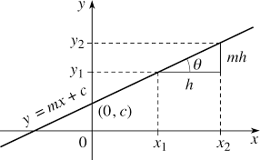
Into The Straight Line
$y=m∗x$ + c
m=$\tan{θ}$
c ➔ intercept on Y-axis

Slide 5
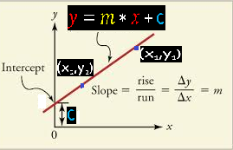
Significance of $m$
$$m=tan{θ}$$
= $\frac{y2−y1}{x2−x1}$
∴ $m$ ➔ change of value of Y per unit change of value along X axis
$m$ = $\frac{dy}{dx}$

Slide 6
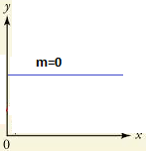
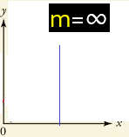
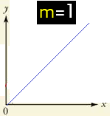
Case Studies on $m$
m=0 ➔ the Line is parallel to X-axis
m=∞ ➔ the Line is parallel to Y-axis
m=1 ➔ the line is inclined at 45 degree
Note: See-Saw Steps are less in 3 cases above

Slide 7
Because, Pixels are Discrete
$y=1.732∗x$ + 2
m =1.732 $≈ \sqrt{3}$
m= $\tan{60°}$
∴
Let is Plot now!
x | y | Decision?
0 | 2 | Exactly 2
1 | 3.732 | 3.8 (Impossible) or 4?
2 | 5.464 | 5 or 5.5 (Impossible)
3 | 7.196 | 7.2 (Impossible) or 7
4 | 8.928 | 9 Or 9.3 (Impossible)
Thus, plotting on Graph is not accurate For, pixels are discrete while points are not!

Slide 8
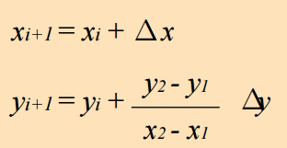
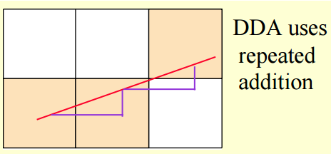
Line drawing Algorithm-1: DDA

Slide 9
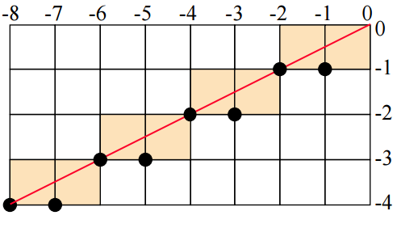
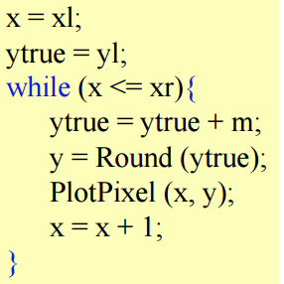
Case -1 : |m| ≤ 1
Switch roles of x and y for |m| >1

Slide 10
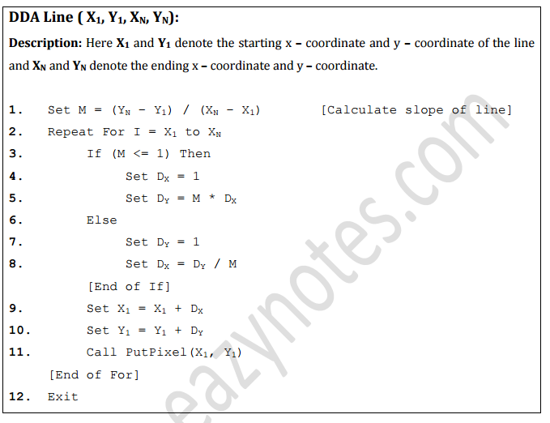
DDA: Easier and Generic Approach
Plotting a Pixel
Differs across
Programming
languages

Slide 11
Do Yourself: Deduction from DDA Algorithm
Set dx= Abs(x₁ – x₂)
Set dy= Abs(y₁ – y₂)
IF (dx ≥ dy) THEN
Number_Of_Steps= dx
ELSE
Number_Of_Steps= dy
END-IF
Δx= $\frac{dx}{\text{Number}\text{_}\text{Of}\text{_}\text{Steps}}$
Δy= $\frac{dy}{\text{Number}\text{_}\text{Of}\text{_}\text{Steps}}$
X_{L} = X₁ ; Y_{L}= Y₁
FOR I=1 To Number_Of_Steps
plot(X_{L} , Y_{L}, Color-You-Like)
X_{L} : = X_{L} + Δx; Y_{L} : = Y_{L} + Δy
NEXT I

Slide 12
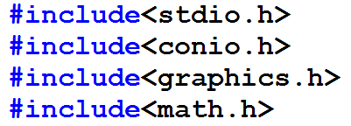
Implementing DDA: A sample Turbo C-Code
This is need for Graphics in Turbo C
This is need for mathematical functions
Common to standard Graphics programs
initgraph(int* graphicsDriver ,int* graphicsMode, char* driverPathAsString): starts graphics system
DETECT: is a macro whose value is 0: indicates to detect graphics system automatically

Slide 13
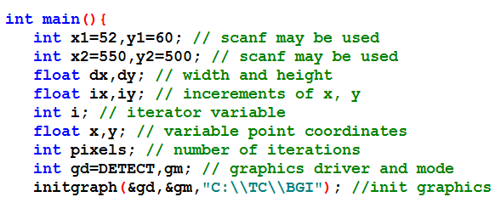
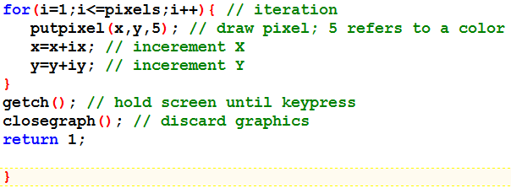
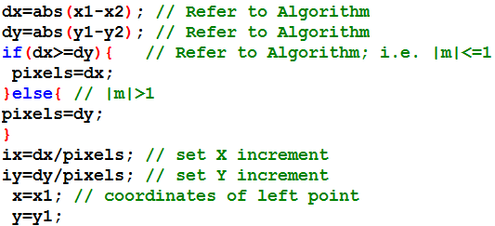
Implementing DDA: A sample Turbo C-Code
This is need for Graphics in Turbo C
This is need for mathematical functions
putpixel(int xCoord,int yCoord, int colorAsInt)

Slide 14
Draw back of DDA Algorithm
Stair –case Output is not optimized considerably
Ceil() or Floor() : Rounding-off is not dynamically decided
Floating point Arithmetic is an overhead
Rounding-off is another computational overhead, too! It also yields low accuracy

Slide 15
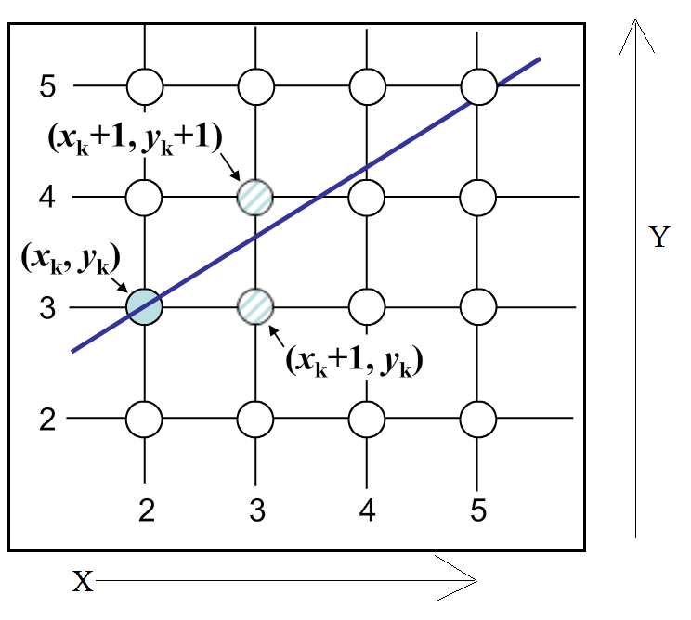
Bresenham’s Line Drawing Algorithm
Given two End Points (X₁, Y₁) and (X₂,Y₂)
Assumption: X₁ < X₂ ∴ (X_{1,}Y₁) is to the left
y= m*x + c
y_{K}= m*x _{K} + c
Increment of X happens from left to right
∴ x_{K+1} = x _{K} +1
But Y_{K+1} =?
Should be: y_{K+1}= m*(x_{K+1}) + c
But it is often a fraction!!!
So, Y_{K+1} is either Y_{K} or (Y_{K} +1)
Original value of Y_{K+1} But it is neither y_{K} nor (y_{K} +1)
D₁ = y_{True} – y_{K} D₂ = (Y_{K} +1) – y_{True}
IF (D₁ < D₂ ) Y_{K+1} = Y_{K}
_{Else} Y_{K+1} = Y_{K} + 1
Bresenhams’ dynamically optimizes it

Slide 16
Bresenhams Line Drawing Algorithm
D₁ = y _{True} _{(K+1)} – y_{K} D₂ = (Y_{K} +1) – y _{True(K +1)}
∴ D₁ = (m * x _{K+1} +c) –y _{K}
D₂ = y _{K+1} - (m * x _{K+1} +c)
∴ D₁ – D₂ = 2*(m * x _{K+1} +c) – y _{K} – y_{K+1}
∵ We move along X-axis, x_{K+1} = x _{K} +1
also, m =$\frac{Δy}{Δx}$ _{, where} $Δx=difference (X1 , X2$)= X₂ –X₁
$Δy=difference (Y1 , Y2$)
; y_{K+1} = y _{K} +1 But y_{K} =y_{K}?
Simplifying:
(D₁ – D₂) * $Δx$ = 2x_{K} * $Δy$ – 2y_{K}? * $Δx$ +2* $Δy+\left(2c−1\right) ∗Δ$x
We define, p _{K} = (D₁ – D₂) * $Δx$
Next value of Y_{K}? = y _{K} if D₁ > D₂ since it is then closer to y _{K}
else Y_{K}? = (y _{K} +1) since it is then closer to (y _{K} +1).
∴ Thus to check is : (D₁ – D₂) ≷ 0 ➔ p _{K} ≷ 0 [∵ $Δx$ >0 left-to- right scanning]
y= m*x + c
y _{True-(K+1)}= m* x _{K+1} + c

Slide 17
Bresenham’s Line Drawing Algorithm
(D₁ – D₂) * $Δx$ = 2x_{K} * $Δy$ – 2y_{K} * $Δx$ +2* $Δy+\left(2c−1\right) ∗Δ$x
p _{K} = (D₁ – D₂) * $Δx$
= (2x_{K} * $Δy$ – 2y_{K} * $Δx$) +[ 2* $Δy+\left(2c−1\right) ∗Δ$x ]
= (2x_{K} * $Δy$ – 2y_{K} * $Δx$) + θ (a Constant Term)
Similarly, p _{K+1} = (2x_{K+1} * $Δy$ – 2y_{K+1} * $Δx$) + θ
∴ p _{K+1} - p _{K} = 2(x_{K+1} – x_{K}) * $Δy$ – 2(y_{K+1} –y_{K} ) * $Δx$
Case-1: p _{K} < 0
x_{K+1} = x _{K} +1; y_{K+1} = y _{K}
∴ p _{K+1} - p _{K} = 2* 1*$Δy$ -2*0 * $Δx$ = 2* $Δy$
➔ p _{K+1} = p _{K} + 2* $Δy$
Case-2: p _{K} > 0
x_{K+1} = x _{K} +1; y_{K+1} = y _{K} +1
∴ p _{K+1} - p _{K} = 2* 1*$Δy$ -2 *1* $Δx$ = 2* $Δy$ - 2 *$Δx$
➔ p _{K+1} = p _{K} + (2* $Δy$- 2 *$Δx$ )
p ₀ =?
y= m*x + c
y _{True-(K+1)}= m* x _{K+1} + c
This is the foundation of Bresenham’s Algorithm

Slide 18
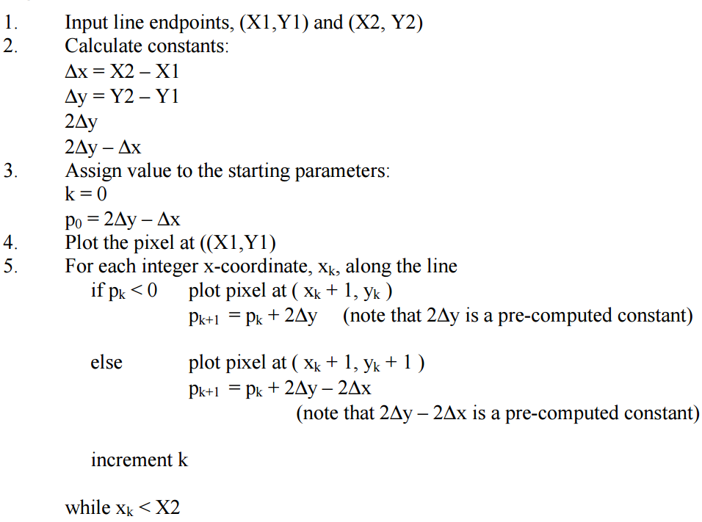
Bresenhams Line Drawing Algorithm
p _{K} =(2x_{K} * $Δy$ – 2y_{K} * $Δx$) +[ 2* $Δy+\left(2c−1\right) ∗Δ$x ]
∴ p ₀ =(2x₀ * $Δy$ – 2y₀ * $Δx$) +[ 2* $Δy+\left(2c−1\right) ∗Δ$x ] … … … [1]
∵ (x₀ , y₀) lie on the straight line :
y= m*x + c ➔ y₀= m*x₀ + c
m= $\frac{Δy}{Δx}$ ➔ c = y₀-m*x₀
Substituting value of c in [1] p ₀ = 2* $Δy$ $−$ $Δ$x
This is Bresenhem’s Algorithm

Slide 19
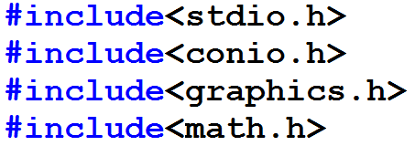
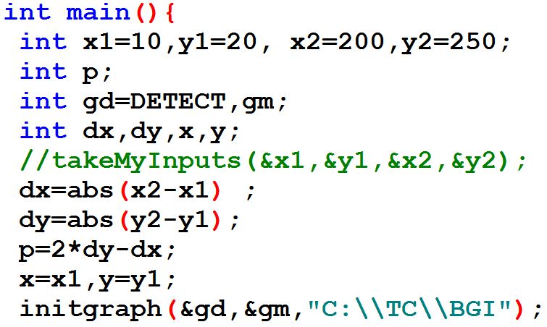
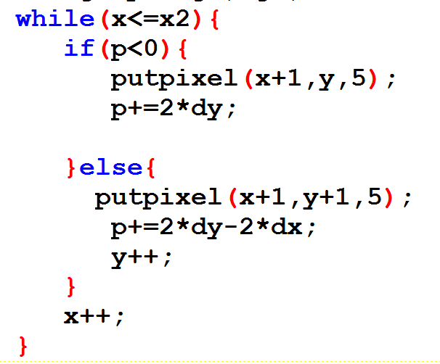
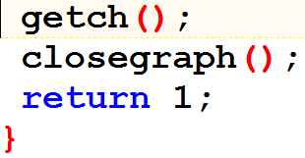
Implementation in Turbo C
When do you get p_{K} = 0 ?
Browse any study material (maybe, on Internet ) and tell this old teacher
“How Bresenham’s Algorithm is different from DDA Algorithm”

