Slide 1
HTML Tables, Servlets and Java Script

Slide 2
<TABLE>
<table border="1">
<tr>
<td>row 1, cell 1</td>
<td>row 1, cell 2</td>
</tr>
<tr>
<td>row 2, cell 1</td>
<td>row 2, cell 2</td>
</tr>
</table>
<table border="1"> <tr> <th>Header 1</th> <th>Header 2</th> </tr> <tr> <td>row 1, cell 1</td> <td>row 1, cell 2</td> </tr> <tr> <td>row 2, cell 1</td> <td>row 2, cell 2</td> </tr> </table>
This is how you specify borders
<table border="1"> <tr> <td>Row 1, cell 1</td> <td>Row 1, cell 2</td> </tr> </table>

Slide 3
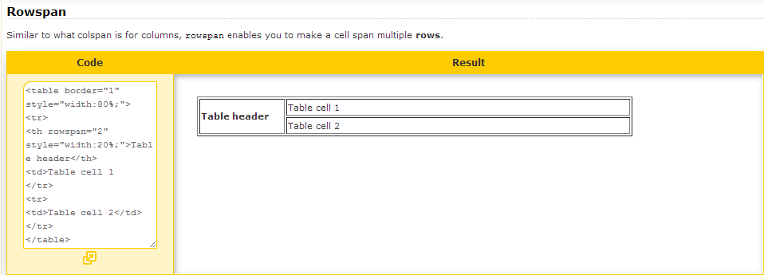
Merged Cells : Rowspan attribute

Slide 4
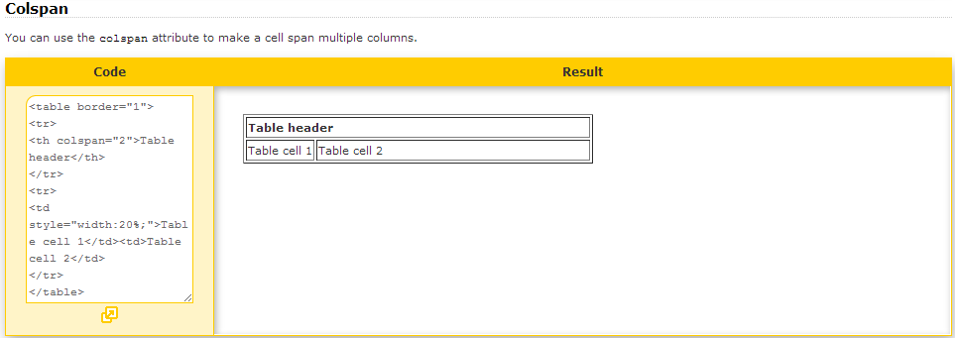
Merged Cells : colspan attribute

Slide 5
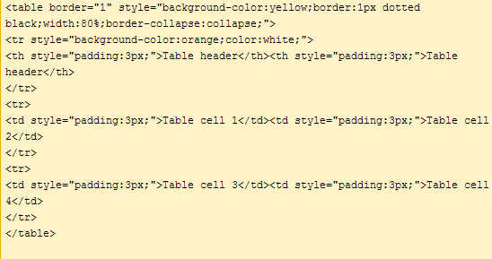
Custom Styles: Add CSS to Table

Slide 6
Generate Tables in Servlet
Steps to follow:
Create the Database (Ignore, if it exists)
Create table and populate with data
Create DSN (for ODBC) (ignore, if exists)
Create a Dynamic Web Application in Eclipse
Create a Java Class that has two static methods to
Connect to the Database aforesaid:
Fetches records from the table in the database.
Close the connection

Slide 7
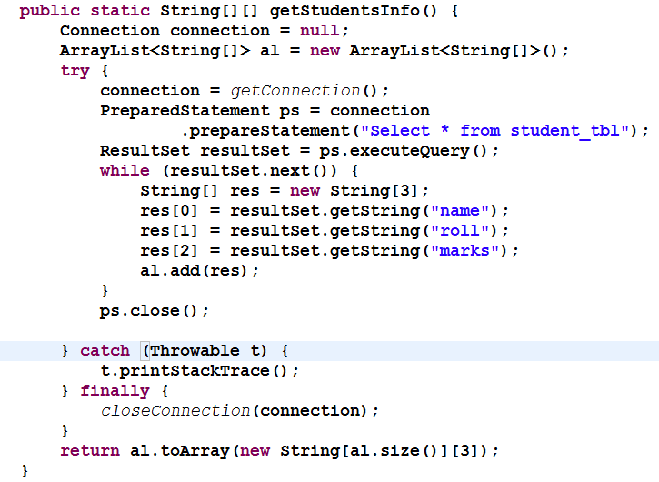
Generate Tables in Servlet… continued

Slide 8
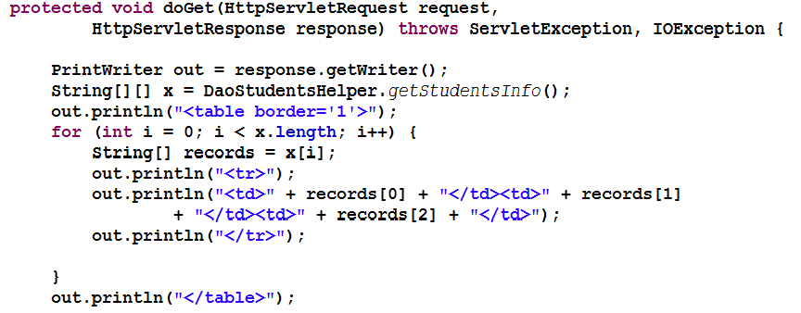
Create & Code a Servlet

Slide 9
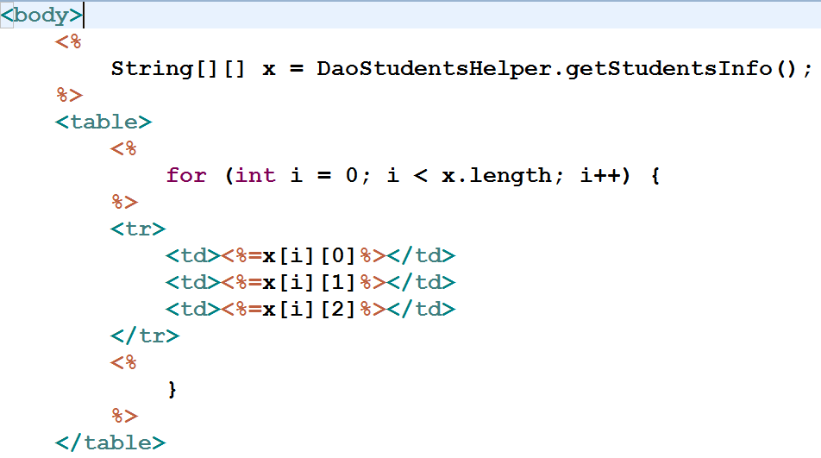
Same within a JSP

Slide 10
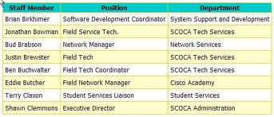
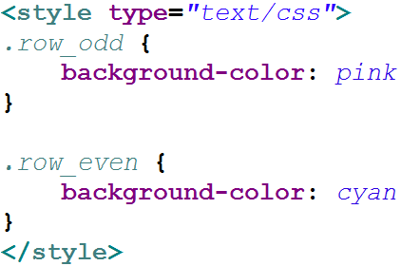
Need for Alternate Row Color

