Slide 1
Digital Image Enhancement
Day-2 : March 14, 2015

Slide 2
Image Enhancement
Topics today: Pixel Processing
Brightness vs. Contrasts
Modify brightness:
Histogram Sliding towards Right
Histogram Sliding to Left
To Intensify Contrast of an Image
Histogram Stretching : Procedure, Limitations
Histogram Equalization
Logarithmic Transforms
Gamma Correction
Log Transform

Slide 3
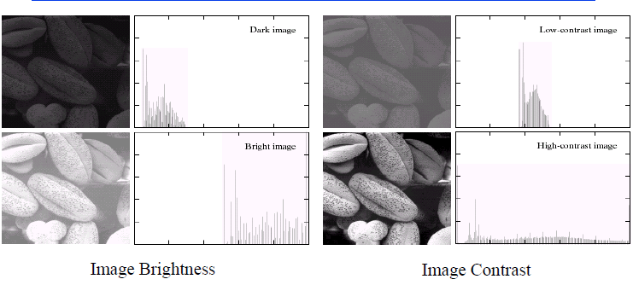
Brightness vs. Contrast

Slide 4
Brightness vs. Contrasts Contd.
To change Brightness of an Image, change the intensity of its pixels
∴ g(x,y) = f(x,y) ± θ ⇨ Brightness of the image is uniformly modified,
if θ be constant , viz. $\frac{δθ}{δx}$ = $\frac{δθ}{δy}$ =0 , ∀ (x,y)
To change Contrast of an Image, widen the pixels’ gray level band
∴ g(x,y) = ψ [f(x,y)] ⇨ Contrast modification with ψ if
histogram of the output image is wider than the histogram of the original image
ψ is intensification operator that can have different implementations

Slide 5
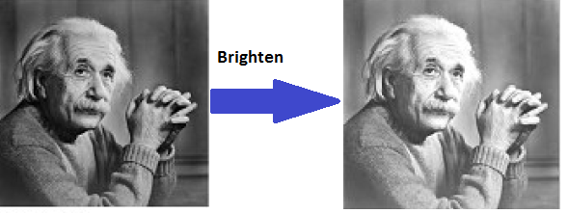
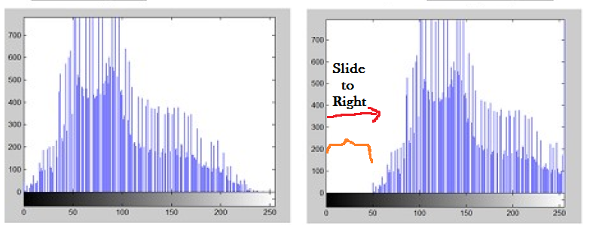
Increasing Brightness (Slide-to-Right)
To increase Brightness of an Image, increase the intensity of its pixels
∴ g(x,y) = f(x,y) + θ ⇨ Brightness of the image is uniformly increased,
if θ>0 be constant , viz. $\frac{δθ}{δx}$ = $\frac{δθ}{δy}$ =0 , ∀ (x,y)
Brightening means to slide to right

Slide 6
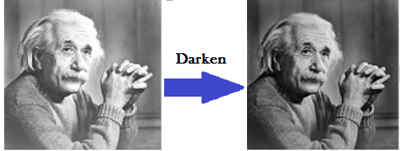
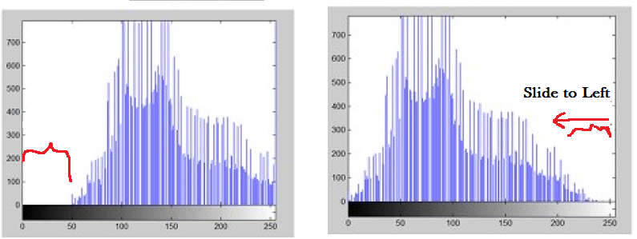
Reducing Brightness (Slide-to-Left)
To reduce Brightness of an Image, reduce the intensity of its pixels
∴ g(x,y) = f(x,y) - θ ⇨ Brightness of the image is uniformly reduced,
if θ>0 be constant , viz. $\frac{δθ}{δx}$ = $\frac{δθ}{δy}$ =0 , ∀ (x,y)
Darkening means to slide to Left

Slide 7
Intensify Contrast: Histogram Stretching
g(x,y)= $\frac{f\left(x,y\right)−fMin}{fMax−fMin}$ * (2 ^{K} -1)
∴ k=8, $fMax$ = 180, $fMin$ = 112
∴ g(x,y)=$\frac{f\left(x,y\right)−112}{180 −112}$ *255
= $\frac{f\left(x,y\right)−112}{68}$ *255
Assume an image :
8-bit Grayscale
Minimum intensity of the pixels= 112
Maximum intensity of the pixels = 180
It fails to enhance the contrast in the following situation:
An image whose minimum intensity=0, maximum intensity =255
g(x,y)=$\frac{f\left(x,y\right)−0}{255−0}$ *255 = $f\left(x,y\right)$

Slide 8
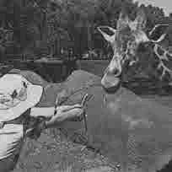
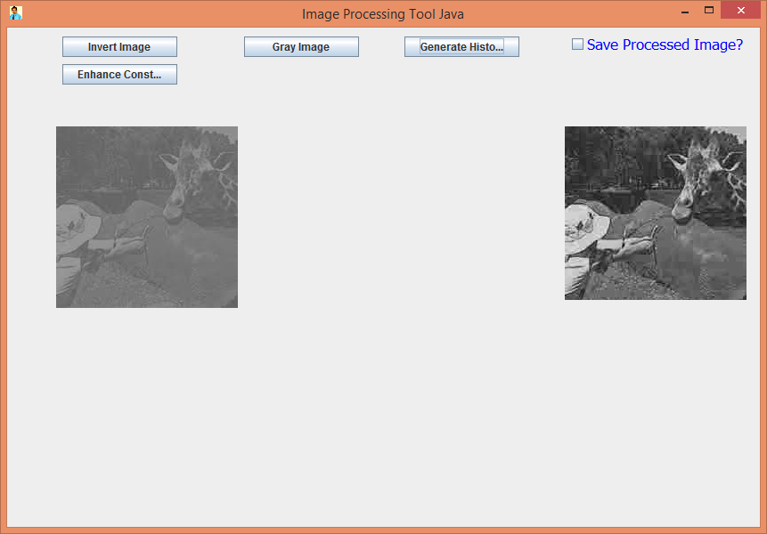
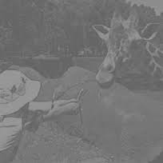
Intensify Contrast: Histogram Stretching Examples
Compare Histograms

Slide 9
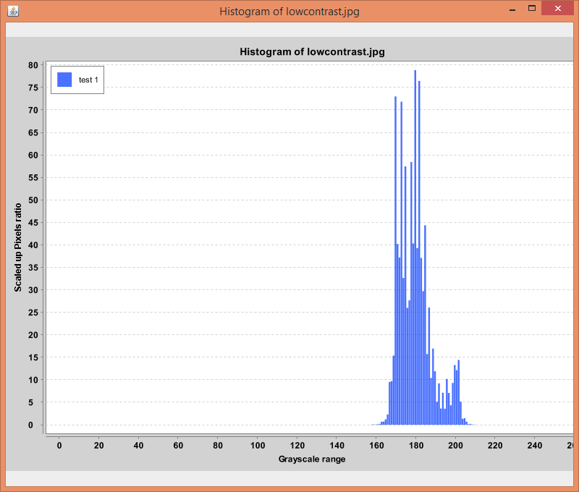
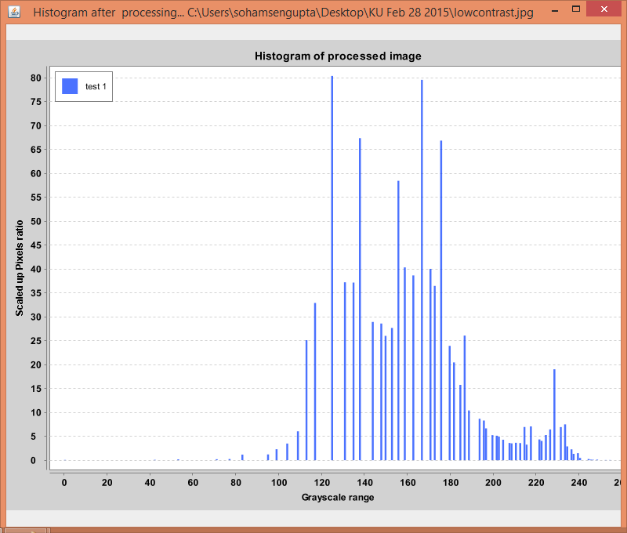
Grayscale band stretched
Histogram is Stretched: Example

Slide 10
Logarithmic Transformations
Types of Logarithmic Transformations:
Log Transform
Gamma Transform (Inverse Log Transform)
Instead of r, we take $\log{(1+r)}$
Otherwise, if intensity of the pixel (r) be zero, we end up with -∞
Instead of r, we take $\log{(1+r)}$
Any base of Logarithm may be used as it only needs to change value of $c$
s=$c\left\{\log{(1+r)}\right\}$ | $c$ > 0 ∧ s<255
s=g(x, y) ⬅ Output Image Pixel Intensity
r= f(x, y) ⬅ Input Image Pixel Intensity
∵ 0≤s≤255 [For 8-bit Images]
∴ $c$ ≤ $\frac{255}{\log\left(1+r\right)}$

Slide 11
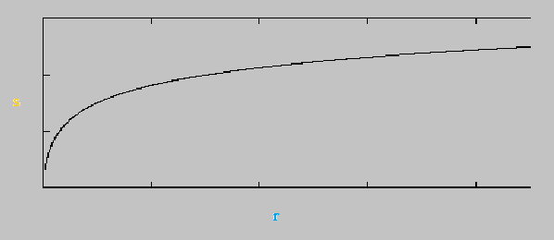
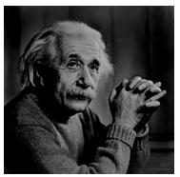
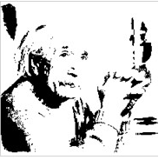
Properties and Utility of Log transform
s=$c\left\{\log{(1+r)}\right\}$ ⇒ $\frac{ds}{dr}$ = $\frac{c}{1+r}$ ⇒ The curve is steep (has high and linearly slope) for small values of $r$; but for larger values it becomes less steep but more widened.
∴the dark pixels in an image are expanded more and high pixel values are compressed

