Slide 1
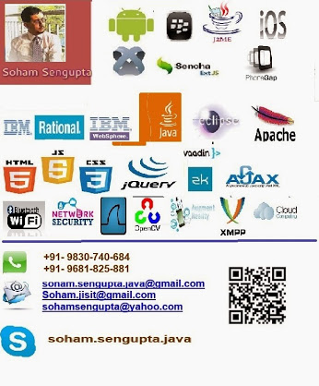
Everyday Technology Uncomplicated & Unleashed
“It is important that students bring a certain ragamuffin, barefoot irreverence to their studies; they are not here to worship what is known, but to question it.” ― Jacob Bronowski, The Ascent of Man

Slide 2
Demo-1: Bengali Simple Text Editor (2006)
Necessity breeds ideas, ideas foster innovation and innovation follows implementation
Soham
Was fond of and incubated literature (Bengali and English)
Urgently needed to compose a Bengali article for a prints-media in typed version
Bangla Word was too sluggish on his 1.2 GHz celeron/512-MB machine
Complex typing rules (Year-2006)
Then?
His own Java simple Bengali editor: (Light-weight) semi-phonetic

Slide 3
Deom-2: Soham’s own XMPP Client (IM-App) 2007
Soham :
Was fond of Linux while surfing Internet due to Lingering Virus attacks to Windows-XP
Had no licensed (purchased) version of any Antivirus
Used to stay on to Google Talk massively for:
Teaching/Helping Students in the evening
Training a bunch of 150+ students for IBM TGMC.
Own consultancy and Industry activities
Using Google Talk on Linux (Debian build) was an issue in 2006.
A pure Java XMPP client running irrespective of platform.

Slide 4
Demo-3: Bluetooth and JSR-82 (2007)
Programming Java ME phones with Bluetooth connectivity
Outcomes:
Multiplayer games
Several research works
Many more
Demo: On-hold, as I will teach you how to program Bluetooth shortly

Slide 5
Years passed….
LOTS of things which never fit in this time span

Slide 6
2013-14: Demos
Remote Control using Android
Flip book converter
Android Education Apps
Android Game(s)
Recharge App
Quick Contact App
Android Automation Apps
Android TV apps (Cannot be demonstrated )

Slide 7
You can judge yourself best
I do not encourage my students to delve in an infeasible research
Own a strong concept
Correlate things you see and what you read in your Texts
Do not always hanker after doing different things; do something existing in a different approach
Would you allow me to separate out members of your family?
At least, I would have beaten you up had you ever tried !
Different subject you learn in your semesters, are members of a family.
Do not ever try to treat them as different, independent entities

